Slide 1

5th IQAC Meeting
WELCOME
Friday
19.9.2025
IQAC

Slide 2
Agenda
Action taken report on the proposals of 4th (38th ) IQAC Meeting.
Student Project framework to integrate SDGs (as per NBA SAR 2024) and multidisciplinary research (as per NEP 2020).
Implementation of faculty internship, SWAYAM MOOC certifications and contribution to SWAYAM/E-content development as per latest NBA SAR July 2024 guidelines.
Issues open for discussion
Academic and Administrative Audit (AAA) and Actions taken thereof during the
AY 2024-25
Awareness on Maturity-Based Grading System under the revised NAAC framework for systematic evaluation and continuous improvement of institutional practices across quality parameters.
Any other item with permission of chairperson.
IQAC

Slide 3
Action taken report on the proposals of 4th (38th ) IQAC Meeting.

Slide 4
Student Project framework to integrate SDGs and Multidisciplinary research
Action taken report on the proposals of 4th (38th ) IQAC Meeting
Current Practices
EPICS and Student Projects –
Current Practices and Gaps
Students undertake projects related to societal or industry problems
Projects are mapped with CO,PO,PSOs only
There is no clear objective to relate these projects to the SDGs
SDGs are not included in project guidelines or evaluation criteria
Some projects may incidentally address certain SDGs without any documentation
Gaps identified in the Current Practices
Projects are not designed to focus or target specific SDGs.
Students lack awareness of what SDGs are, or how to apply them
Faculty may not be guiding students to think in terms of global sustainability objectives
There is no systematic process or rubric to assess the SDG relevance of projects
Limited exposure to interdisciplinary project framing - SDGs require interdisciplinary thinking
Proposed Action Plan by IQAC
To address these gaps IQAC proposes
To conduct a FDP on SDG integration in Academics in the October 2025
A defined framework to identify and evaluate SDG contributions in student project works.
IQAC

Slide 5
Student Project framework to integrate SDGs and multidisciplinary resea
Action taken report on the proposals of 4th (38th ) IQAC Meeting
Planned a two day FDP in October month
Guidelines to implement SDGs
 | Embedding SDGs in Curriculum and Research Two days Faculty training program on SDGs
Day-1 | Sessions
 | Session 1:Overview of All SDGs-Covering basic definitions, examples and creating awareness of all SDGs
 | Tea break
 | Session 1:Overview of All SDGs-Continuation of all SDGs interaction, Handouts, group actvities -
 | Lunch Break
 | Session 2: Teaching and Learning Methods towards SDGs
 | Tea Break
 | Session 3: Hands on Training on Curriculum mapping with SDGs( for Running courses and new courses)
 | Tea Break
 | Session-4:Implementation of SDGs in OBE
Day-2 | Sessions
 | Session 5:Student Project mapping with SDGs
 | Tea break
 | Session 7:Research work mapping with SDGs
 | Lunch Break
 | Session 7:Linking SDGs with Accreditation Criterias & Quality Benchmarks
 | Tea Break
 | Session 8: Overview of 4 Prioritized SDGs Templates for Courses and Projects
Role of Supervisor
Role of Project Coordinator
& PAC
Facilitate formation of interdisciplinary student teams across departments.
Conduct an SDG orientation session and share the list of 17 UN SDGs.
Provide standardized templates for proposals, SDG mapping, reviews, and reports.
Use SDG-based assessment rubrics consistently across all project stages.
Assign a primary supervisor and co-supervisor to each project.
Monitor project progress and SDG compliance during scheduled reviews.
Ensure access to labs, software, tools mutually, and promote student innovation and dissemination
SERVICES
Validate SDG Mapping done by the student group.
Ensure Continuous Alignment with selected SDGs throughout the project duration.
Provide Technical Guidance and domain-specific inputs.
Support Resource Planning and use of relevant tools/software.
Offer Milestone Feedback to enhance sustainability and social relevance.
Guide SDG Reporting for inclusion in project reports and presentations.
5

Slide 6
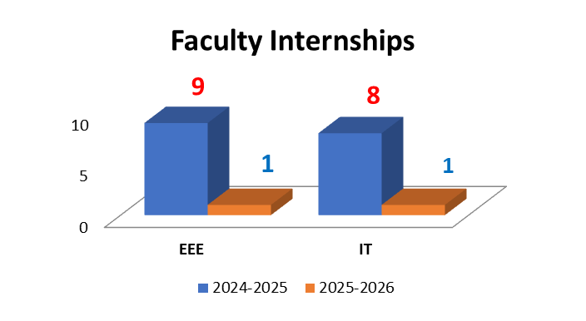
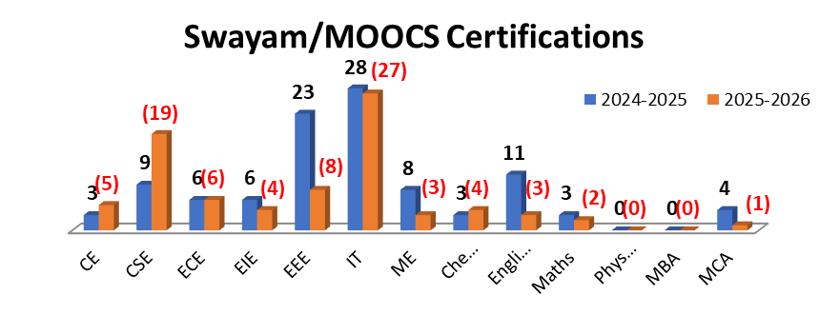
Implementation of faculty internship, SWAYAM MOOC certifications and contribution to SWAYAM/E-content development as per latest NBA SAR July 2024 guidelines
Action taken report on the proposals of 4th (38th ) IQAC Meeting
Total No. of Swayam/MOOCS Certifications:
2024-2025: 104
2025-2026: (82-still in Progress)
6
IQAC

Slide 7
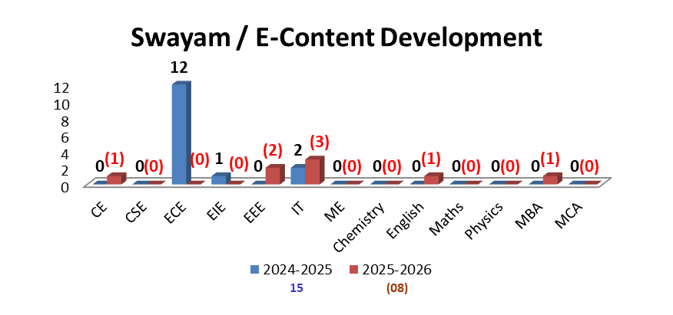
Implementation of faculty internship, SWAYAM MOOC certifications and contribution to SWAYAM/E-content development as per latest NBA SAR July 2024 guidelines
Action taken report on the proposals of 4th (38th ) IQAC Meeting
7
IQAC

Slide 8
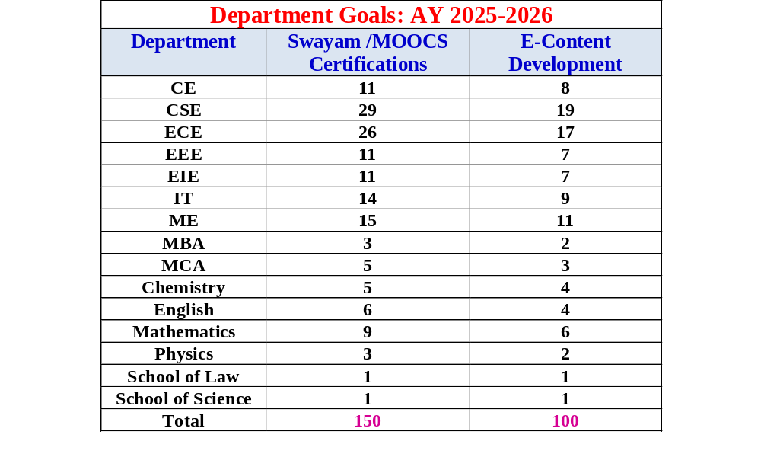
Implementation of faculty internship, SWAYAM MOOC certifications and contribution to SWAYAM/E-content development as per latest NBA SAR July 2024 guidelines
Action taken report on the proposals of 4th (38th ) IQAC Meeting
8
IQAC

Slide 9


Implementation of faculty internship, SWAYAM MOOC certifications and contribution to SWAYAM/E-content development as per latest NBA SAR July 2024 guidelines
Action taken report on the proposals of 4th (38th) IQAC Meeting
Facility for E content preparation- Recording Room
IQAC

Slide 10



Issues open for Discussion
Any other item with permission of chairperson.
1
3
Awareness on Maturity-Based Grading System under the revised NAAC framework for systematic evaluation and continuous improvement of institutional practices across quality parameters.
Academic and Administrative Audit (AAA) and Actions taken thereof during the AY 2024-25
2

Slide 11
Academic and Administrative Audit (AAA) and Actions taken thereof during the AY 2024-25

Slide 12
Academic and Administrative Audit (AAA) and Actions taken thereof during the AY 2024-25
Annual Academic Audit (AAA):
Basic Sciences Departments - Internal Auditors
Engineering Departments of School of Engineering - External and Internal Auditors
School of Business - Internal Auditors
Computer Applications - Internal Auditors
S.No | Academic and Administrative Audit criteria's
1 | POs, PSOs and Curriculum
2 | Faculty information and their contribution
3 | Teaching- Learning process and Evaluation
4 | Research, Consultancy and Extension
5 | Infrastructure and Learning Resources
6 | Student Information, support and progression
7 | Governance, Leadership and Management

Slide 13
Academic and Administrative Audit (AAA) and Actions taken thereof during the AY 2024-25
Samples
 | Strength | Weakness
 | 24-25 | 24-25
EEE | Faculty members are actively contributing in Industry Collaborations | No faculty contributions in Institute (IITs /NITs) Collaborative projects
 | Students placements are more in number and more faculty are contributing in placements for students | No funded R&D Projects in the Department, needs to be focused
 | Department has introduced seven value added courses for AY:2024-25
 | Department is maintaining good Teacher-Student ratio and Cadre ratio, faculty experience and retention ratio are also good
 | Supports remote work and study
 | Strength | Weakness
 | 24-25 | 24-25
ECE | Good number of research projects | Pass percentage of 1st year students’ needs improvement.
 | Good number of PhD qualified faculty | GATE qualified students number is less
 | PhD scholars guided by faculty are good in number

Slide 14
Academic and Administrative Audit (AAA) and Actions taken thereof during the AY 2024-25
 | Strength | Weakness
 | 24-25 | 24-25
CSE | Documentation and File Maintenance is well maintained | Number of Q1 and Q2 Journals is less compared to the total number of faculty available in the department
 | Projects Worth of Rs.2.20 Crores is evidenced in 2024-25 | Very less number of ICT based sessions are recorded for the students convenience
 | New Laboratories worth Rs.5.71 crores are established
 | Motivated Faculty in the department
 | Supports remote work and study
Samples
 | Strength | Weakness
 | 24-25 | 24-25
EIE | Good infrastructure and core Job opportunities | No Consultancy activities in the Department
 | Faculty Qualification and retention | Startups and Entrepreneurship activities are nil in the department
CE | Good infrastructure facility | Placements need to be improved. The average salary looks low, this need to be improved
 | Strong FSR | Requires enhanced emphasize on research development
 | Young faculty with lot of energy to contribute both academics and research

Slide 15
Academic and Administrative Audit (AAA) and Actions taken thereof during the AY 2024-25
Sample
 | 23-24 Suggestions | Outcome in 2024-25
IT | Students need to attend good reputed conferences and present the work in offline at reputed universities | Increased Student Participation – All students were able to submit papers to reputed A* conferences annually with 50% offline attending. Incentives were offered to all the papers presented physically at conferences
 | Product-based projects must be encouraged | Among the total student projects 20% of the projects are product-based projects in A.Y: 2024-25 Technical events participations – 64 · Participation & Recognition – Students achieved 6 prize-winning positions in reputed Hackathons at regional, national, and international levels between Aug 2024 – Apr 2025. · Awards & Cash Prizes – Secured 3 major cash prizes totaling ₹35,000, reflecting competitive excellence. · National & International Exposure – Recognition at platforms such as BITS Pilani, VIT-AP, Potti Sriramulu Engineering College, and South Asia’s largest women-open Gen AI Hackathon highlights global competitiveness. · Skill Development – Demonstrated excellence in AI, problem-solving, innovation, and teamwork under high-pressure environments (20–24-hour hackathons).
 | Seed Grant projects must be continued with as proposal submission to external R&D | 05 Seed Grant Projects were sanctioned in 24-25 with a total worth of ₹ 6,63,740/-
2024-25 | BC-34 | Scopus Conf-83
2023-24 | BC-31 | Scopus Conf-62

Slide 16
Academic and Administrative Audit (AAA) and Actions taken thereof during the AY 2024-25
Sample
 | 23-24 Suggestions | Outcome in 2024-25
EEE | Online Programs/webinars are not conducted | Students got awareness on Electronics area for choosing as a career option.
 | No International events is conducted | 2024 International Conference on Computational Intelligence for Green and Sustainable Technologies (ICCIGST-2024) was organized by the Department in association with ECE & EIE. Papers received: 602, Papers accepted: 212, Papers presented:142 Peer reviewed papers were published in IEEE Xplore (Scopus Indexed).Total papers published were 142.
 | No new Textbooks are added to dept library | Procured 35 new textbooks to Department library. These new books are for faculty and student references and purchased books fall under these areas. i) Electric Vehicle Technology ii)Artificial Intelligence iii) Machine learning iv) Programming in Python v) Data Structures and Algorithms in Python
 | No field projects executed by the students | i) N.Sai Kiran of IV/IV EEE from Drones club got placed in Garuda Aerospace Pvt Ltd with a pay of 3.5 LPA. ii) J.Francis of IV/IV EEE from Drones club got placed in Mantra Solutions with a pay of 3 LPA. iii) A. Naveen of IV/IV EEE from Drones club got placed in Drones based company with a pay of 3.96 LPA. iv) Four students of IV/IV EEE got internship opportunity to work at IIT Tirupati NiF for the project titled “Precision Landing of the Drone” from January 2025 to May 2025 v) Two students of IV/IV EEE got placed at Peepuls Agri Ventures LLP, Hyderabad, with a pay of 4 LPA.

Slide 17
Awareness on Maturity-Based Grading System under the revised NAAC framework for systematic evaluation and continuous improvement of institutional practices across quality parameters.

Slide 18



Binary Accreditation
As per High Level Committee Headed by Dr.K.Radhakrishnan
( former chairman of ISRO)
Institutional Binary Accreditation | Parameters | Minimum Score
Universities | 55 | 50%
Autonomous Colleges | 50 | 45%
Affiliated Colleges | 40 | 40%
Accreditation process is complete, and institution is accredited
No more NAAC Grades
No mad race
No Egos
√ Accredited or
Not accredited.
Far below expectation
Not Accredited
Accredited

Slide 19
Key Features of Maturity Based Graded Accreditation (MBGA)
Binary + Maturity
Hybrid Model
First, an institution must pass the binary accreditation (Yes/No)
If "Yes", it is assigned
a maturity level
(1-5)
If "No", it must improve
and be reapplied
Credibility Scoring
Focus on Continuous Improvement
Digital & Evidence- Based Evaluation
Institutions must progress to higher maturity levels over time
Regular
reassessments
ensure sustained quality
Incentives for
Higher
Maturity Levels

Slide 20



IV
Levels of Institutions on basis of Growth and Maturity
V
III
Size of the institution
II
I
Academic Data, Research Data, Innovation metrics
Established Institutions
Advanced Institutions
Institutions of Global
Excellence
Emerging
Institutions
Developing Institutions
Quality Assurance Documentation
Four levels based on the above parameters. This
could also be for graded autonomy
Fifth level: Institution of Global Excellence based on Multidisciplinary research & Education.
MATURITY-BASED GRADED LEVELS (MBGL)
International Level
National Level

Slide 21














It is aligned with NEP-2020
Single point data entry by HEIIs with continuous
updates – validate from stakeholders
Binary Accreditation
There are no peer team visits – Online visits in exceptional cases
10 Attributes of quality for all HEIs – University, Autonomous & Affiliated colleges
Metrics under each attribute – focus on input, process , outcome , impact
1st stage–Binary accreditation system (normal accreditation) 2nd stage – Maturity based graded accreditation

Slide 22
Outcome based education
Critical and creative thinking skills among the students
Experiential learning
Problem solving
Project based learning
Improving knowledge, skills, competencies and behaviour/attitude of students
Nearly 50-60% new metrics in new NAAC accreditation,
more complex
Research. Innovation, Incubation, Startup
No CGPA, No grading, Metrics are recognised as Good, Concern & weak. But, HEIs may goes for Maturity based graded Accreditation (Level 1 to 5)
Importance is Given To
5th IQAC Meeting, 19th September 2025, SU

Slide 23



Input (225)
Correlation between New Reforms and Existing Criterias
Existing NAAC Criterion (Key Indicators) | Proposed Binary Accreditation Framework - Attributes
1. Curricular Aspects | 1. Curriculum design (Input)
2. Teaching- Learning and Evaluation | 2. Faculty Resources (Input) 5. Learning & Teaching (Process)
3. Research, Innovations and Extension | 9. Research and Innovation Outcomes (Outcome)
4. Infrastructure and Learning Resources | 3. Infrastructure development (Input)
5. Student Support and Progression | 6. Extended Curricular Engagements (Process) 8. Student Outcomes (Outcome)
6. Governance, Leadership and Management | 4. Financial Resources and Management (Input) 7. Governance and Administration (Process)
7. Institutional Values and Best Practices | 10. Sustainability Outcomes & Green Initiatives (Outcome)
Total Assessment 1000
Attributes (900)
Outcome (325)
Process (350)
Uniqueness(100)

Slide 24

(i) Curriculum Design
Input | Process | Outcome | Impact
Source of the content which is open for public viewing in their portals | Students Feedback • Teachers Feedback • Stakeholders involvement • Method of periodic Up-gradation • Review mechanism • Transparent responsible and inclusive methods of functioning • Expanding access to high-quality Technical and Vocational Education and Training • Emphasizing the importance of enabling life-long learning focused on skilling, reskilling, and up skilling especially for vulnerable groups • Encourage mobility of students, scholars across higher education institutions | Successful completion of Course (Passing) • Updated knowledge • Innovative ideas/ways of exercising policies/ patents/ high impact publications, books • Time management catering to the needs of the semester system Teaching content contextualised leading to real-world skilling in the learners • Enable personal accomplishment and enlightenment, constructive public engagement, and productive contribution to the society • Multidisciplinary and holistic education. | Progression towards higher level of education, educatedness in the society. • Increased possibilities of skilled work- force leading to placement or self- generated jobs • Rise of involvement in entrepreneur- ships /innovations • Awards/recognitions/ Inventions/ Wealth generation • Prepare students for more meaningful and satisfying lives and work roles and enable economic independence
5th IQAC Meeting, 19th September 2025, SU
24

Slide 25

ii) Faculty Resources
Input | Process | Outcome | Impact
Applications Received | Shortlisting procedure • Personality aspects • Pedagogy • R&D aptitude • Constitution of Selection Committee • Integrated Score with appropriate weightage • Continuous professional development of teachers through the Malviya Mission Programme and other similar programmes approved by UGC/AICTE with appropriate weightages • Appropriate consideration of faculty selection parameters (e.g. Professional skills like performing arts, visual arts; writing case studies for management institute faculty) and practical based selection • Consideration of parameters for ensuring social inclusivity measures in the HEIs (gender parity/ disabled/ trans-person/SDGs) with appropriate weightages | • Merit-based selection with due importance to equity and diversity • Reflection in career path of students | • Student progression towards higher level of education in good institutions/ professional life /social acceptance and moulding them to be responsible citizens of the nation. • High quality faculty that contribute towards the implementation of NEP 2020

Slide 26
(iii) Infrastructure Development
Input | Process | Outcome | Impact
Infrastructure Development | • Details of land, classroom, research laboratory, computer Centre, workshops, restaurant, theatre, dining hall, library, administrative office, faculty rooms, central stores, security, housekeeping, examination control office, placement office, common room, first aid cum sick room, guest house, sports club/ Gymnasium, auditorium, hostel • Logistics for infrastructure for connecting to the students, faculty and staff | • Holistic view of the existing capabilities of the institution. • Judgement of capabilities for expansion | • Better outcomes from students and their academic courses • Creates an eco-system that ensures that a healthy development of courses, students, faculty, and staff takes place.

Slide 27
iv) Financial Resources and Management
(
Input | Process | Outcome | Impact
Financial Resources & Management | • Seed money for teachers, students and researchers • Support for conferences, workshops, equipment, research etc. to students, teachers and researchers. • Amount spent on developing facilities, library, e-resources, labs, training teachers and staff for undertaking outreach activities • Amount spent on salary of teaching and non-teaching staff • Amount spent on Seminars/ Workshops/Conferences • Expenditure on infrastructure augmentation • Amount received in donation and CSR funds • Revenue generated from outreach activities • Total amount spent on developing facilities, training teachers and staff for undertaking outreach activities • Utilized amount on library, labs, workshops, other expenditure, salary of teaching and non-teaching staff, maintenance of infrastructure, consumables, Seminars/Workshops/ Conferences, each value given separately for each of the last 3 financial years | • Detailed overview of the financial health and existing capabilities of the institution. • Judgement for expansion of the institutes | •Better judgment about the outcomes from student, faculty and researchers • Creates an eco-system that ensures that a healthy development of student, and faculty can be correlated

Slide 28
(v) Learning and Teaching
Input | Process | Outcome | Impact
• Diversity of content & contemporary issues in content delivery | • Normal classroom practice (Top down approach) • Interactive method collaborative/ contextual learning • Field work & evaluation • Experiential learning • Critical thinking and problem solving methods • Inculcating research oriented study • Cultivating deeper interest in the subject to learn by self-efforts • Harnessing digital technologies to overcome the digital divides for all learners • Promoting open, equitable and secure scientific collaboration across research and higher education institutions | • Holistic and contextual understanding of the subject and impact of learning in life • Need to have a benchmark of learning outcome • Promotion of research activity and new areas of thoughts • Developing the aptitude of connecting insights across domains | • Attainment of learning outcome, progression in studies & profession • Contribution towards different areas of learning /research through new and innovative critical ideas and thoughts • Promotion of self-sufficiency • Creating confident citizens

Slide 29
(vi) Community Engagement
Input | Process | Outcome | Impact
• Curriculum & engagement with society • Outreach activities • Projects / internships executed on real-world problems | • Social outreach and Community Engagement • Involvement of students to connect with society in the context of curriculum • Social research in collaboration with concerned bodies • Adoption of nearby institutions, bodies or villages • Exchange programmes | • Understanding the relevance of curriculum for effective social and community engagement • Increased involvement of the students in the societal level and realizing their sense of responsibility as a social being | • Better acceptability of the institutions by society • Community improvement in terms of health, education & economic upliftment
5th IQAC Meeting, 19th September 2025, SU
29

Slide 30
(vii) Governance and Administration
Input | Process | Outcome | Impact
Act, Statutes, Regulations, Policies | • Implementation conforming to Act, Statutes, Regulations, Policies. • Amendment procedure. | • Better conflict resolution | • Transparency in Governance
Mission to achieve the vision. | Innovation in Governance to be evaluated based on Implementation of eGovernance, Decentralization, participative management strategies. • Implementation of the G20 High-Level Principles on Lifestyles for Sustainable Development (LiFE) with appropriate weightage • Appropriate weightage for availability of an effective Grievance Redressal Mechanism and resolution of complaints • Appropriate weightages for performance related statistics like increase in enrolment, gender parity ratio, SC/ST/OBC/EWS Student enrolment • Appropriate weightage for strategies adopted for promotion of internationalization of education (e.g. UGC ) | • Level of Implementation with examples in different areas • Increased Gross Enrollment Ratio(GER) | • Timeline of execution of administrative tasks • Helps in better management of the institution and its admin • Restoration of India’s role as a Vishwaguru

Slide 31
(viii) Extracurricular (EC) and Co-Curricular (CC) Activities
Input | Process | Outcome | Impact
Credit for EC/CC activities | • Incentivization (financial etc.) and special focus to marginal sections • Logistic, connecting to the syllabus | • Holistic concepts of institutional learning • More complete realization of human potential | • Representation of students in national/ larger bodies • Creates an eco-system that uncovers innate talents in the society
5th IQAC Meeting, 19th September 2025, SU

Slide 32
(ix) Research and Innovation
Input | Process | Outcome | Impact
• New imagination • New problems in research • Proper policy for promotion of research and research facilitation | • Interdisciplinary approach • Collaborative approach • Research addressing local and regional issues of societal concern & global issues like climate change and world economy • Out of the box and fearless thinking that reduces the ‘fear-of-failure’ barrier to develop sensitivity towards diversity in the society • Promoting open, equitable and secure scientific collaboration and encouraging mobility of researchers and scientists across research and higher education institutions | • Publications • Patents Innovations & Start-ups • Participation of collaborative institutions in research • Translational work | • Increase in Citations • Peer group recognition • Stakeholder impact • Better funding of research by industry and other agencies

Slide 33
(x) Green Initiatives
Input | Process | Outcome | Impact
Credit for Green Initiatives | • Use of renewable energy • Waste Management • Environment friendly initiatives, e.g., Green building, Eco restoration • Spreading awareness among stakeholders • Rainwater harvesting and water recycling • Appreciation towards the importance of achieving SDGs rapidly | • Orientation towards environmental friendly actions • Shift towards renewable energy | • Reduction of carbon footprint

Slide 34





Attributes
Curriculum alignment to Program and Course Outcomes (PO/PSOs andCOs)
Curriculum Flexibility – MEME, ABC, Electives, Dual Degree, Twinning, Mother Tongue,
Inter-Institutional Credit Transfers, Criticization of EC and CC
% of Skill Oriented Courses aligned with NSQF & Skill Focus
% of Online Courses through SWAYAM
Indian Knowledge System Incorporation
1. Curriculum Design
Faculty Recruitment Processes; Transparency
Whether pay and allowances as per UGC/AICTE Norms
Faculty Diversity, Faculty Cadre, % of faculty working continuously for last 3 years
2. Faculty Resources
New Metrics introduced/ Modified
Learning Management System; Augmented reality (AR) and virtual reality (VR), Virtual Labs
Research Resources – Plagiarism Check; Software-Statistical, Simulation etc.
Divyangjan – Assistive Technology Facilities etc.
3. Infrastructure
Uniqueness / Situatedness – Not disclosed
Financial Sustainability & Growth; Corpus; Decentralized Budgeting
Risk Management Strategies
Financial Resources
& Management
Surveys/ Feedbacks at different instants/ Criterions
Learning &
Teaching
New Pedagogical Techniques – Kinesthetic learning; Game based learning
Continuous Evaluation: MCQ; Portfolio; Case Study; Open Books etc

Slide 35

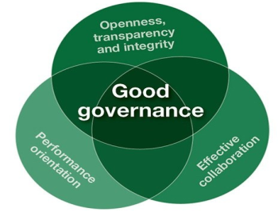



Attributes
Technical/Domain Clubs; Activities; Chapters of Professional bodies
Hackathons – Conducted; Students Participations!
Cultural Clubs & Activities
Mental Health, Meditation etc
Impact of Institution on Communities; Clean Village; Disease free Village;
Empowered Women Communities; Adaptation of Villages under UBA
6. Extended Curricular Engagements
Institutional Development Plans; Strategies & Interventions
Digital India Policy Guidelines; e-Governance; Use of Samarth e-governance; NAD/ABC Implementation
Effective Leadership; Effective delegation of powers
Health & Life Insurance; Campus in-house creche, staff quarters etc
Grievances - Ombudsman
7. Governance and Administration
% of Students Graduating against the enrolment
Students & Alumni – Learning Experience – Survey
8. Student Outcomes
9. Research & Innovation Outcomes
National/International Faculty; Community based Research; Technology Transfer
10. Sustainability Outcomes (Including Green Initiatives)
Carbon sequestration; Air Pollution; Water Budgeting; Paper waste recycling
5th IQAC Meeting, 19th September 2025, SU

Slide 36

Uniqueness
Credibility Scoring :
  Calculation starting from base score 0.5, adjusted for accuracy and feedback
Peer Data Validation (PDV) :
  Validate the data for Binary grading – from stakeholders – students, parents, alumni (majority of past three years) etc. ,
AI-Driven Data Validation:
    Automated Cross-Checks:
      AI compares institutional submissions with AISHE, Scopus, LinkedIn, and patent databases.
      Example: AI cross-verifies with employer records if an HEI claims 100% placements.
Fraud Detection:
  Blockchain logs prevent data tampering.
  Suspicious entries flagged for manual audit

Slide 37
Any other item with the permission of Chairperson

Slide 38

IQAC

