Slide 1





WELCOME
to
8th IQAC Meeting
Tuesday
30.06.2026
IQAC

Slide 2
Agenda
Action taken report on the resolutions of the 7th IQAC Meeting.
Establishment of Research Centres and Centres of Excellence.
Discussion on implementation of Sustainable Development Goals through research initiatives and community engagement activities
Issues open for discussion
Review and Strengthening of Entrepreneurship Development Cell (EDC) Activities
Discussion on Strategies for Enhancing the University Perception
Any other item with the permission of Chairperson.

Slide 3
Action taken report on 7th IQAC Meeting
Agenda#1: Establishment of Research Centres and Centres of Excellence
The details of the proposed Centres of Excellence/ Research labs by the Departments
The details of the proposed Central Research & Analytical Instrumentation Laboratory
Agenda#2: implementation of Sustainable Development Goals through research initiatives and community engagement activities
Identified research projects with the support of government bodies and NGOs aligned with SDG’s
Identified research Projects on society and community issues aligned with SDG’s

Slide 4
Proposed Centre of Excellence: Department of Artificial Intelligence
Name of CoE | Geospatial Artificial Intelligence and Spatial Analytics
Investigators | Dr. M.Suneetha (PI), Professor & Head (AI), Dean (R&D) Dr. V.Radhesyam, Associate Professor Dr. V. Satya Sahithi, Assistant Professor
Thrust Area | Development of GeoAI and geospatial analytics solutions Advanced remote sensing and natural resource management applications Support disaster resilience through geospatial tools and platforms
Budget(in Rs.) | 49.678 Lakhs
Objectives | Develop GeoAI and spatial analytics for intelligent decision support Advance remote sensing and geospatial solutions for resource management Create geospatial tools for disaster resilience and climate adaptation
Duration | 1-2 Years for the establishment of CoE
Expected Outcome | 5 Technologies, 10 Prototypes/Pilot Projects 2 Consultancy Projects, 25 Research Publications and (2 Patents Filed/Granted) 10 PhD Scholars and 2 Sponsored Research Projects

Slide 5
Proposed Centre of Excellence: Department of Civil Engineering
Name of CoE | Centre of Excellence in Earthquake Geotechnics
Investigators | Dr. Ch. Rama Vara Prasad (PI) Dr. V. Mallikarjuna
Thrust Area | Resilient and Sustainable Geotechnical Infrastructure Engineering
Budget(in Rs.) | 30 Lakhs
Objectives | Advance Research in Geotechnical Infrastructure Develop Sustainable Ground Engineering Solutions Enhance Infrastructure Safety and Technology Transfer
Infrastructure establishment duration | 1 Year
Expected Outcome | Advanced Earthquake-Resistant Geotechnical Solutions Innovative Ground Improvement and Reinforced Soil Technologies Predictive Models for Geohazard and Infrastructure Risk Assessment High-Impact Research, Consultancy, and Technology Transfer

Slide 6
Proposed Centre of Excellence: Department of ECE
Name of CoE-1 | CENTRE OF EXCELLENCE IN CHIP DESIGN AND FABRICATION TECHNOLOGIES (COE-CDFT)
Investigators | Dr. CH. Naga Raghuram (PI), Sr. Assistant Professor Dr. G.L. Madhumati, Professor Dr. G. Kishore Kumar, Associate Professor
Thrust Area | VLSI Design, SoC Architecture & FPGA Prototyping Analog/Mixed-Signal/RF IC Design & TCAD Simulation Emerging Semiconductor Devices & Advanced Sensor Technologies
Budget(in Rs.) | 1.78 Crore
Objectives | Establish advanced EDA infrastructure for chip design research. Develop innovative VLSI and emerging semiconductor technologies. Build skilled manpower in end-to-end SoC and chip design
Duration | 1 Year for the establishment of CoE
Expected Outcome | Advanced VLSI designs, SoC prototypes, and semiconductor innovations. High-quality publications, patents, and funded research projects. Industry-ready skilled professionals in chip design and verification

Slide 7
Proposed Centre of Excellence: Department of ECE
Name of CoE-2 | CENTRE OF EXCELLENCE IN Advanced Navigation, LiDAR and Autonomous Systems
Investigators | Dr. A Ravi Raja(PI), Assistant Professor Dr. Shaik Fayaz Ahamed, Associate Professor Dr. R V H Prasad, Assistant Professor
Thrust Area | Positioning, Navigation & Timing (PNT) Systems LiDAR, SLAM & Digital Twin Technologies Autonomous Systems, Robotics & AI Navigation
Budget(in Rs.) | 1.5 Crore
Objectives | Advance navigation, LiDAR, and autonomous system technologies Develop AI-enabled digital twin and smart infrastructure solutions Promote research, innovation and skilled workforce development
Duration | 1 Year for the establishment of CoE
Expected Outcome | Advanced Technologies, Prototypes & Digital Twin Solutions Research Publications & Patents Skilled Researchers & Advanced Laboratory Infrastructure

Slide 8
Proposed Centre of Excellence: Department of ECE
Name of CoE-3 | Centre of Excellence in Nanotechnology Research, Innovation, and Advanced Device Fabrication
Investigators | Dr. Binay Binod Kumar(PI), Assistant Professor Dr. Ball Mukund Tripathi (Co-PI), Sr. Assistant Professor
Thrust Area | Design and Fabrication of Chemiresistive Gas Sensors array for detecting VOCs associated with breast cancer, Lung Cancer, hazardous gas detection and prototype devices integrating with machine learning.
Budget(in Rs.) | 1.856 Crore
Objectives | Develop advanced sensor technologies for early disease diagnosis and environmental monitoring. Design AI/ML-enabled smart sensing systems for rapid and accurate detection. Promote translational research in intelligent sensing for healthcare, industrial safety and environmental applications.
Duration | 5 Year for the establishment of CoE
Expected Outcome | Hands on Training in software simulations and fabrications to UG, PG and PhD scholar, Reputed Research Publications & Patents, Prototypes & Advanced Laboratory Infrastructure

Slide 9
Proposed Centre of Excellence: Department of EEE
Name of CoE | Renewable Energy Systems, Smart Grids and Sustainable Energy Technologies
Investigators | Dr. Subhojit Dawn(PI) Dr. B. Venkateswara Rao Dr. M L N Vital
Thrust Area | Renewable Energy Systems & Hybrid Technologies Energy Storage Green Hydrogen & Smart Grids IoT-Based Sustainable Energy Management
Budget(in Rs.) | 2.25 Crore
Objectives | Develop innovative renewable energy and smart energy technologies Advance AI-enabled energy management, smart grids and microgrids Promote skill development, industry collaboration and sustainable energy solutions
Duration | 2 Years for the establishment of CoE
Expected Outcome | Prototype Development & Technology Transfer Research Publications & Patents Skilled Manpower & Consultancy Services

Slide 10
Proposed Centre of Excellence: Department of EIE
Name of CoE | Biomedical Instrumentation & MEMS Sensors Research Laboratory (BIMSRL)
Investigators | Dr. M. Srinivas(PI) Dr. S. Srinivasulu Raju Dr. Kalpana Seelam
Thrust Area | Biomedical Sensing and Instrumentation Systems, Smart Healthcare and Remote Monitoring Technologies and Bio-MEMS, Microfluidics and Lab-on-Chip Systems
Budget(in Rs.) | 63 Lakhs
Objectives | Establish advanced research facilities in biomedical instrumentation, MEMS sensors and smart healthcare technologies. Develop innovative and affordable healthcare solutions including biomedical devices and smart diagnostic tools. Promote interdisciplinary research and collaborations in Bio-MEMS, microfluidics and intelligent healthcare.
Duration | 2 Years in two Phases for the Infrastructure establishment
Expected Outcome | Development of Biomedical and MEMS-Based Technologies Functional Prototypes Enhanced Research Output through patents, publications, consultancy, and funded projects.

Slide 11
Proposed Centre of Excellence: Department of ME
Name of CoE | Centre of Excellence in Energy and Fuel Cell Technologies
Investigators | Dr K Nagamalleswara Rao(PI) Dr V Vasu Dr M Jogendra Prasad
Thrust Area | Biomass energy and fuel cells
Budget(in Rs.) | 1 Crore
Objectives | Development of advance renewable energy storage technologies. Develop efficient fuel cell-based energy systems. Promote sustainable biomass and biofuel technologies
Duration | 2 Years for the establishment of CoE
Expected Outcome | Development of Biomedical and MEMS-Based Technologies Functional Prototypes Enhanced Research Output through patents, publications, consultancy, and funded projects.

Slide 12
Proposed central research and analytical instrumentation lab : Department of S&H
Name of CoE | Material Characterization and Analysis Lab
Investigators | Prof. Ch. Baby Rani Dr. K. Narendra Dr. K.S.K.R. Chandra Sekhar and other Team
Thrust Area | Nano Materials, Crystals, Magnetic Materials and Mathematical Modeling
Budget(in Rs.) | 5.18 Crore
Major Equipment | X-Ray Diffractometer- 1 Crore, IR Spectrophotometer – 35 Lakhs, GPU-Accelerated HPC Server- 15 Lakhs, Field Emission Scanning Electron Microscope-2.8 Crore, Impedance Analyser,- 45 Lakhs Planetary Ball Milling Instrument -15 Lakhs
Duration | 1 Years for the establishment of centralized facilities
External Advisory Committee members | From CSIR New Delhi, IIT Kanpur, NITW, BPCL Noida
Objectives | Develop advanced nanomaterials for sustainable energy applications. Apply advanced characterization and computational modeling for material design. Create eco-friendly materials and technologies for environmental sustainability.

Slide 13
Action taken report on the Agenda #2 of 7th IQAC Meeting: Implementation of Sustainable Development Goals through research initiatives and community engagement activities
Identified research projects with the support of government bodies and NGOs aligned with SDG’s.
S No. | Department | Title of the research Project | Name of the Government body/ NGOs | Thrust area | Aligned SDG
1 | AI | Developing local scale impact evaluation tools using geospatial system to assess natural development mission outcomes and SDG goals | NRSC-ISRO, Hyderabad | Geo-AI, Remote Sensing & GIS | SDG 6: Clean Water Sanitation
2 | AI | GeoAI-driven Urban Heat Island Intensity (UHII) Mapping Framework for Indian cities | AP Pollution Control Board, AP State Climate Change Cell | Geo-AI, Remote Sensing & GIS | SDG 13: Climate Action
3 | EIE | A Non-Invasive Wearable Surrogate Marker System for Early Kidney Stress Detection | Andhra Pradesh MedTech Zone (AMTZ), Vizag | Healthcare AI | SDG 3: Good Health and Well-being
4 | EIE | IoT-Based Smart Water Quality Monitoring System for Rural Communities | Pollution Control board, AP Govt. | Sustainable Rural Water Management | SDG 3: Good Health and Well-being
5 | ME | Development of Sustainable Biodegradable Agro-Waste Composites for Low-Cost Housing Applications | CIPET Vijayawada | Sustainable Materials and Green Technologies | SDG11:Sustainable Cities and Communities
6 | ME | AI-Assisted Design and Optimization of Solar Thermal Energy Systems Using Satellite-Based Solar Irradiation Data | ISRO | Solar thermal energy | SDG 7 – Affordable and Clean Energy

Slide 14
CSE Dept: Identified research projects with the support of government bodies and NGOs aligned with SDG’s
S. No | Name of the Government Body / NGO | Title of the Identified Research Project | Aligned SDG | Thrust Area
7 | ISRO | Machine Learning Model Development to Analyze Historical and Real-Time Sensor Data for Predictive Maintenance of Launch Pad Systems | SDG 9: Industry, Innovation and Infrastructure | Artificial Intelligence, Predictive Maintenance, Aerospace Systems
8 | IIT Tirupati Navavishkar I-Hub | DeployAR: AR-Integrated Geo-Spatial Digital Twin Platform for GNSS-Denied Multi-UAV Swarm Coordination | SDG 9: Industry, Innovation and Infrastructure | Augmented Reality, Digital Twins, UAV Systems, Geospatial AI
9 | ICMR, New Delhi | Neuro Sense: AI-Driven EEG Wearable for Early Detection of Cognitive Fatigue and Stress in Clinical Professionals | SDG 3: Good Health and Well-being | Healthcare AI, Wearable Computing, Brain-Computer Interfaces
10 | IIT Tirupati Navavishkar I-Hub | Neuromorphic Edge AI for Vision-Based Positioning and Navigation in Intelligent Space Missions | SDG 9: Industry, Innovation and Infrastructure | Edge AI, Neuromorphic Computing, Computer Vision, Space Technology
11 | ICMR-NICHDR, New Delhi | Diabetes and Hypertension Telemedicine Platform | SDG 3: Good Health and Well-being | Telemedicine, Digital Health, Healthcare Analytics

Slide 15
Identified research projects with the support of government bodies and NGOs aligned with SDG’s.
S No. | Dept. | Title of the research Project | Name of the Government body/ NGOs | Thrust area | Aligned SDG
12 | EEE | Enhancing grid stability and sustainability in electrical markets: A Review on the synergy of renewable energy and EVs | Central Electricity Authority and Ministry of New & Renewable Energy (MNRE) | Renewable Energy | SDG 11: Sustainable Cities and Communities
13 | EEE | AI/ML based state of Health Estimation for Lithium-ion Batteries in Electric Vehicles | NASA and Center for Advanced life cycle Engineering, Battery datasets | Battery Management systems(BMS) | SDG 7: Affordable and Clean Energy
14 | CE | Strategies for Integrating Non- Motorised Transportation with Urban Public Transit Systems | Ministry of Housing and Urban Affairs | Sustainable Cities and Communities | SDG 11 : Sustainable Cities and Communities
15 | CE | Utilizaton of plantain fibre for slope erosion and stability applications | Society of Agriculture and Rural Development (SARD) | Sustainable Natural Fibre | SDG 15: Life on Land
16 | ECE | Design And Development Of A Beam-Steering Phased Array Receiver For Ground-Based Telemetry Signal Tracking | Armament research & development establishment (arde), pune | Radio Frequency Engineering | SDG 9: Industry Innovation and Infrastructure
17 | ECE | Development of a Real-Time Dynamic Magnetic Anomaly Compensation System for Fluxgate Magnetometers Using AHRS and Zynq FPGA for Underwater Applications | Naval Science and Technological Laboratory | Advanced Underwater Sensing, Navigation | SDG 14: Life Below Water

Slide 16
Research projects on Community issues and societal technical problems aligned with SDG’s.
S No | Title | Research Area | SDG Goal | Department
1 | Investigation on Urban Flooding and Drainage Congestion | Urban Flood Management | SDG 11: Sustainable Cities | CE
2 | Groundwater Depletion and Water Scarcity studies | Climate-Resilient Water Management | SDG 6 :Clean Water and Sanitation | CE
3 | Smart Plastic Waste Management and Recycling System | Circular Economy and Recycling | SDG 12: Responsible Consumption and Production | CE
4 | AI-Enabled Precision Agriculture for Smart Crop and Resource Management | Precision Agriculture & Smart Farming | SDG 2: Zero Hunger | AI
5 | Sensor-Based Soil Nutrient Monitoring System for Precision Farming | Smart Agriculture | SDG2: Zero Hunger | EEE
6 | AI-Enabled Early Disease Detection for Rural Healthcare | AI for Preventive Healthcare | SDG3: Good Health & Well-being | CSE
7 | AI-Enabled Early Detection and Intervention Support for Autism Spectrum Disorder | Digital Health Technologies | SDG 3: Good Health and Well-being | CSE
8 | IoT-Based Water Quality Monitoring System for Drinking Water Sources | Water Resource Management | SDG6:Clean Water & Sanitation | EIE
9 | Real-Time Air Quality Monitoring and Alert System for Urban Areas | Environmental Monitoring | SDG3: Good Health & Well-being | ECE
10 | IoT-Based Smart Waste Bin Monitoring System for Efficient Waste Collection | Smart Cities, IoT | SDG 11:Sustainable Cities & Communities | ECE

Slide 17



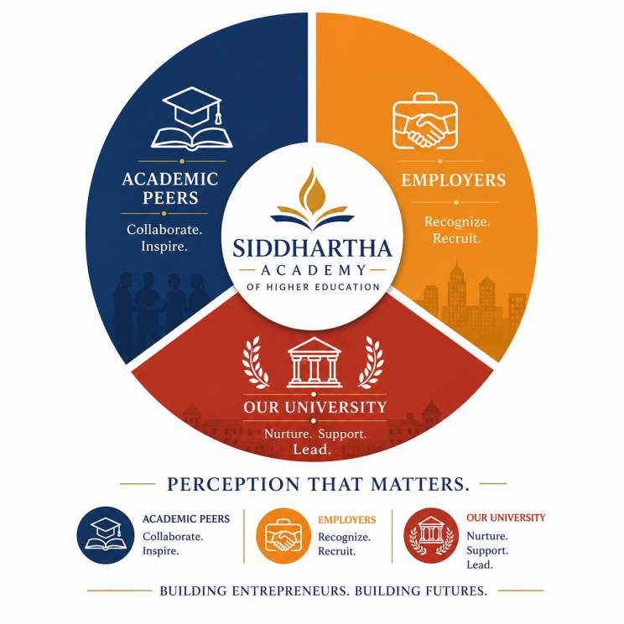
Agenda points for open for Discussion
3
Any other item with permission of chairperson.
1
Review and Strengthening of Entrepreneurship Development Cell (EDC) Activities
2
Discussion on Strategies for Enhancing the University's Perception

Slide 18
ENTREPRENEURSHIP DEVELOPMENT CELL (EDC)
Innovation • Startups • Research Commercialization • Industry Collaboration • Societal Impact
WHAT IS EDC?
  • Institutional platform for entrepreneurship & innovation
  • Nurtures ideas into startups
  • Promotes incubation, mentoring, IPR and commercialization
  • Connects academia, industry and investors
WHY EDC FOR A DEEMED-TO-BE UNIVERSITY?
  • Creates an innovation ecosystem
  • Transforms research into patents & startups
  • Enhances employability & job creation
  • Strengthens industry collaboration
  • Supports NAAC, NBA, NIRF, NEP 2020, UGC Binary Accreditation & MBGL
  Contributes to Atmanirbhar Bharat & Startup India
OBJECTIVES
  • Develop entrepreneurial mindset
  • Identify & mentor innovators
  • Support incubation & startup creation
  • Facilitate IPR & patent filing
  • Enable industry & investor networking
  • Promote funding opportunities
  • Organize workshops & hackathons
Transforming Ideas → Innovation → Startups → Societal Impact

Slide 19
Innovation & EDC Requirements Across National Quality Frameworks
NEP 2020
  Ch.16 Professional Education
  Ch.19 Effective Learning
  Ch.20 Research & Innovation
  Innovation • Entrepreneurship • Startups
NAAC
  Criterion 3
  KI 3.2 Innovation Ecosystem
  KI 3.3 Research
  KI 3.5 Collaboration
NBA
  SAR Criteria 1,3,7,9
  Innovation
  Industry Interaction
  Project-based Learning
NIRF
  TLR • RP • GO • PR
  Patents
  Startups
  Consultancy
UGC Binary
  Innovation Ecosystem
  Incubation
  Entrepreneurship
  Research Translation
MBGL
  Innovation Culture
  Industry Collaboration
  Societal Impact
  Institutional Excellence
EDC is the institutional mechanism that enables Innovation, Startups, IPR, Industry Collaboration and Accreditation Excellence.

Slide 20

UGC- INSTITUTIONAL DEVELOPMENT PLAN (IDP) GUIDELINES — FEBRUARY 2024
Entrepreneurship as a Core Institutional Priority—Not an Optional Activity
Aligned with NEP 2020, the IDP framework embeds entrepreneurship across institutional mission, academic design, research and startup-support systems.
Reference | UGC –IDP Guideline (Exact Text) | Institutional Focus
Social & Academic Mission Sec. II · Clause iv · p.7 | “Creation of industry fit and entrepreneurial human resources for improving quality of life, the standard of living, all-round development, wellbeing and social good.” | Entrepreneurial human-resource creation
Main Objectives & Goals Sec. IV · Clause vi · p.10 | “To establish ethos of holistic lifelong learning and an operative framework to promote the better employability and entrepreneurship, by integration of skilling into Higher Education.” | Employability & entrepreneurship via skilling
Strategic Goals Sec. V-A · Clause iv · p.12 | “Foster entrepreneurship and experiential learning among both students and faculty.” | Entrepreneurship & experiential learning
Research, IP & Supportive Enablers Sec. VI-D · Clauses l, m · p.23 | (l) “Offering mentorship and support to startups.” (m) “Exploring funding mechanisms and cultivating an entrepreneurial culture.” | Startup mentoring, funding & entrepreneurial culture
Academic Enablers Sec. VI-C · Clause xvii · p.22 | “Promote commercial business ideas while mentoring the student and becoming part of their Start-up ecosystem.” | Student ideas → startup ecosystem

Slide 21

TECHNOLOGY BUSINESS INCUBATOR (TBI)
V R Siddhartha TBI Foundation
Sponsored by Siddhartha Academy of General & Technical Education
Reg. No. 120807 • Registered as a Not-for-Profit Section-8 Company (Companies Act, 2013)
20+
₹1.84L+
2017–2024
12+
Start-ups Incubated
Seed Fund Disbursed
Years of Operation
Sectors Supported
Promoting innovation & entrepreneurship in smart agriculture, healthcare and allied sectors across Vijayawada and its surrounding rural region.
SECTORS REPRESENTED
Aerospace
AgriTech
Aquaculture
Service Innovation
Software Services
Electric Vehicles
EduTech
Waste Management

Slide 22













Objectives & Incubation Services
How the TBI drives innovation-led entrepreneurship in the region
OUR OBJECTIVES
TBI SERVICES
Foster innovation & entrepreneurship in smart agriculture, healthcare and allied sectors across rural Vijayawada.
Mentoring & networking with experts, partners and investors
Translate multidisciplinary research into products, technologies and patents.
Free advisory — legal, financial, technical & IPR
Skill development & technology training programmes
Build entrepreneurship skills among students, faculty and the wider rural community.
Idea bootcamps, accelerators & innovation contests
Provide incubation infrastructure and seed funding for promising start-up ideas.
Pre-incubation support for business plans & IPR
Connect mentors, experts, angel investors and venture capitalists for funding and business support.
Linkages with the wider start-up community
Enable speedy commercialisation of technology, driving job creation and economic growth.
Financial assistance through start-up seed funding

Slide 23
Complete List of Start-ups Incubated
All 20 start-ups incubated since 2017, across departments and sectors
# | Start-up | Founder(s) | Sector | Yr
1 | NPHSAT Systems Pvt. Ltd. | Praveen Naidu & Neelima | Aerospace | 2019
2 | Miletronics Pvt. Ltd. | Lokesh Vanka & Ratna Kumari | Aqua Culture | 2020-21
3 | Verlito Waste Mgmt Pvt. Ltd. | Parthive & team | Waste Mgmt | 2022
4 | Uvkos Technologies LLP | Parthive & Umadevi | Food & Beverages | 2023
5 | FarmX Innovations Pvt. Ltd. | Siva Nagaraju & Dudiya Naik | AgriTech | 2021
6 | Simulated Virtual Solutions | Kranthi | Real Estate | 2022
7 | Sidnik Magna Pvt. Ltd. | Nikhil Babu & Vaditya | Service Innovation | 2022
8 | GKH Solutions Pvt. Ltd. | Gurram Kiran & Nuvula | Service Innovation | 2022
9 | CS Codenz Educational Society | — | EduTech | 2021
10 | Hardisa Design & Construction | Hasheer Shaik & team | Design & Construction | 2018
# | Start-up | Founder(s) | Sector | Yr
11 | Sastra Tech and Automation | Bhanu Kiran | Service Innovation | 2023
12 | InfiStitch Services Pvt. Ltd. | Srilavanya Kallam & team | Smart Tailoring | 2018
13 | Radar Storage Services Pvt. Ltd. | Anil Kumar & team | Service Innovation | 2018
14 | Kremlin Tech Ventures Pvt. Ltd. | Akshay Kumar & team | Software Services | 2017
15 | Madblocks Technologies Pvt. Ltd. | Madhusudhana Rao & Archana | IoT / EduTech | 2019
16 | Athritek Innovations India Pvt. Ltd. | Ineni Chaitanya & team | Aqua | 2021
17 | Chitti Motors Pvt. Ltd. | Mohan Murali & Avinash | Electric Vehicles | 2024
18 | NAZEN Technovations LLP | Khayim Ahmed & Abhinava Reddy | Supply Chain | 2024
19 | Sri Mahasya Home Foods (Grihasta) | Sornala Vijaya & Lakshman | Food & Health | 2024
20 | Sarvadhara Tech Innovations Pvt. Ltd. | Sunitha & Sateesh | Software Services | 2024

Slide 24
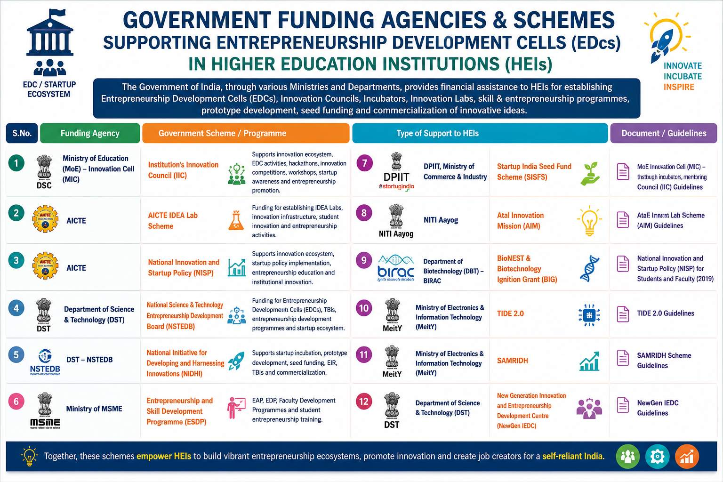

Slide 25
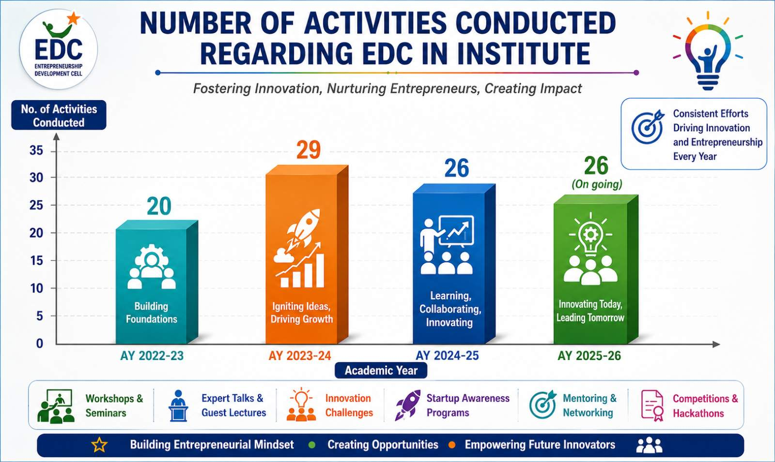
NUMBER OF ACTIVITIES CONDUCTED ON ENTREPRENEURSHIP IN UNIVERSITY

Slide 26
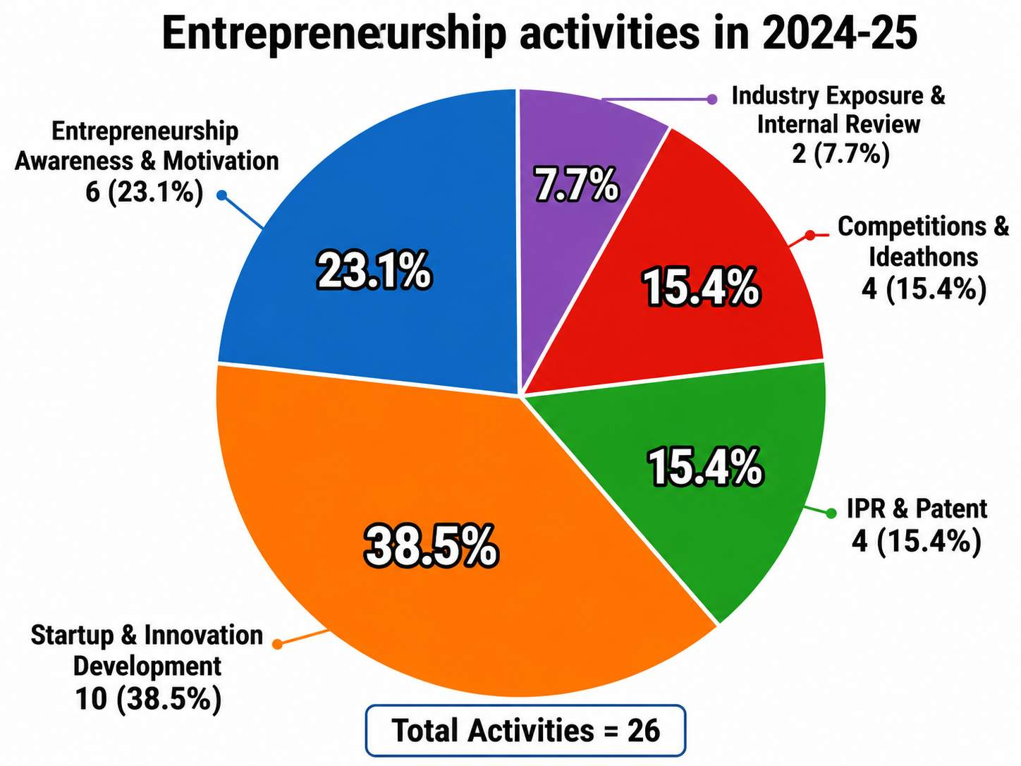
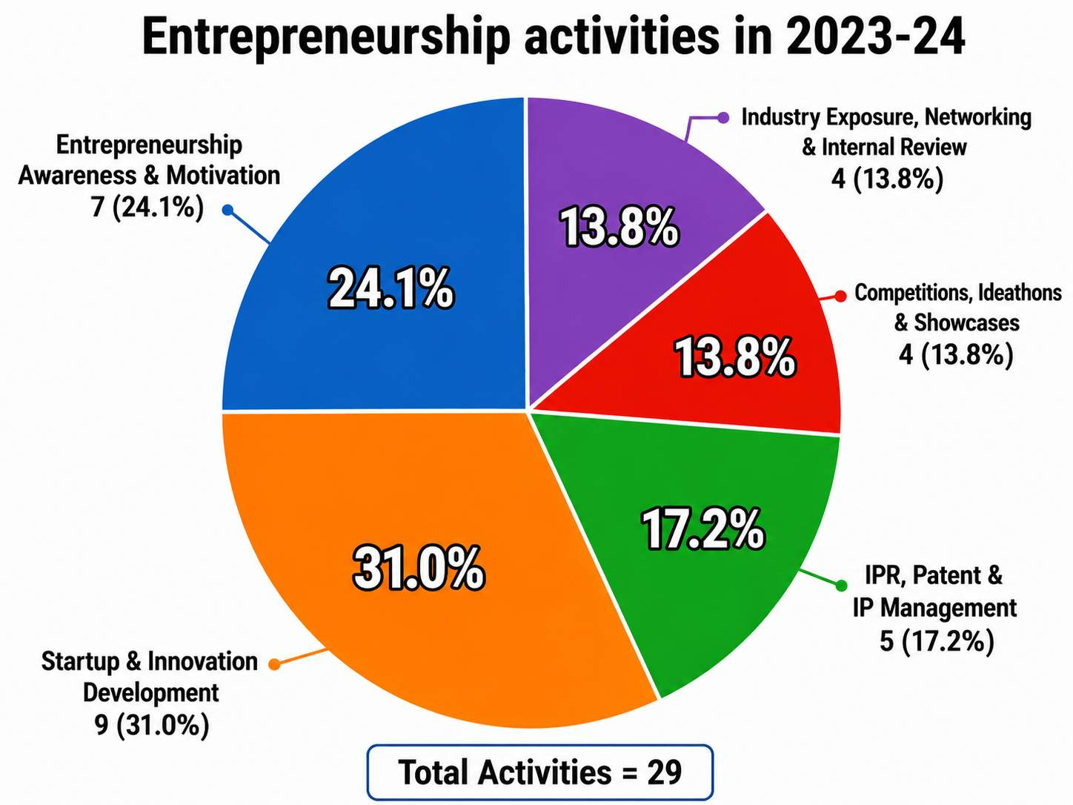
Entrepreneurship and Innovation activities Conducted

Slide 27
AICTE IDEA Lab – Sanctioned Details
Item | Description
Scheme | AICTE IDEA Lab (Idea Development, Evaluation & Application)
Funding Agency | AICTE, Ministry of Education, Government of India
Total Project cost | 90 Lakhs
Status | Sanctioned and under implementation
Objectives of Lab | Promote innovation through hands-on design and prototyping. Enhance creativity, critical thinking and problem-solving skills. Foster startups and an entrepreneurial culture.

Slide 28
Comparison of Functions of EDC and IIC National Quality Frameworks
Institution's Innovation Council (IIC): MoE Innovation Cell | Entrepreneurship Development Cell (EDC): National Science & Technology Entrepreneurship Development Board (NSTEDB)
Innovation ecosystem | Entrepreneurship awareness
Promote innovation & ideation | Promote entrepreneurship & start-ups
Design thinking, IPR & innovation culture | Entrepreneurial skill development
Hackathons, idea challenges & innovation contests | Business planning, mentoring and incubation
Industry interaction & innovation networking | Funding, project support & venture creation
Innovation portal & recognition of innovators | Industry linkages & enterprise development
References
1.Ministry of Education Innovation Cell (MIC). Institution's Innovation Council (IIC) – Functions & Operational Guidelines. https://iic.mic.gov.in/assets/html/index.html
2.National Science & Technology Entrepreneurship Development Board (NSTEDB), Department of Science & Technology, Government of India. Guidelines for Establishment of Entrepreneurship Development Cells (EDCs). https://www.nstedb.com/institutional/edc_guidelines_2008.pdf

Slide 29
Benchmarking of Entrepreneurship Development Cell (EDC) with Leading Deemed-to-be Universities
Area | Observation | Status
Entrepreneurship Awareness Programmes | Regular entrepreneurship awareness sessions, motivational talks and expert lectures comparable to leading deemed universities. | AT PAR
Startup & Innovation Development | Regular startup orientation, innovation workshops, ideation programmes and entrepreneurship development activities. | AT PAR
IPR & Patent Promotion | Strong emphasis on IPR awareness, patent workshops and expert sessions. | AT PAR
Hackathons, Ideathons & Competitions | Periodic innovation challenges, business plan competitions and ideathons. | AT PAR
Integration with National Innovation Initiatives | Active implementation of IIC, AICTE, MSME and Startup India initiatives. | AT PAR
Industry & Startup Ecosystem Linkages | Expand sustained engagement with startup founders, incubators, investors and venture capitalists. | NEEDS STRENGTHENING
Structured Startup Mentorship | Establish a formal mentoring framework involving alumni entrepreneurs and industry experts. | NEEDS STRENGTHENING
Prototype to Product Development | Strengthen the prototype-to-commercialization pipeline. | NEEDS STRENGTHENING
Institutional Seed Funding | Introduce a dedicated institutional seed fund for early-stage student startups. | To be Improved
Comprehensive Incubation Ecosystem | Develop a full-fledged incubation ecosystem with year-round support. | To be Improved
Startup Commercialization & Outcome Tracking | Strengthen tracking of startup registration, funding, commercialization and revenue generation. | To be Improved

Slide 30
Roadmap to Strengthen Innovation & Entrepreneurship
As per UGC-IDP Guidelines, February 2024
TBI
AICTE Idea Lab
Institution's Innovation Council (IIC)& EDC
Existing Centres for Innovation
ROADMAP TO STRENGTHEN — 4-STEP ACTION FLOW
JUL
AUG
ONGOING
AUG
31
10
10
2026
2026
Continuous
2027
Re Constitution of EDC & TBI Team
Integration of IIC and EDC and rename innovation and entrepreneurship cell to foster innovation, entrepreneurship and startup development
Funding to Support EDC
Ecosystem
Innovation-to-Startup
Pipeline
Notify the core team for the Innovation & Entrepreneurship Development Cell (EDC) and Technology Business Incubator (TBI).
Secure funding to support Student, Faculty & Industry entrepreneurship initiatives across the ecosystem.
Capacity building to convert ideas from the Idea Lab into a structured, mentor-supported startup pipeline.
T

Slide 31
Siddhartha Academy of Higher Education (SAHE)
8th IQAC Meeting
2nd Agenda Point for discussion
Strategies for Enhancing University Perception

Slide 32
University Perception
The collective opinion about
Academic reputation/ Placements/ Industrial relations/ Research excellence/Innovation eco system/ Graduate Employability / Institutional visibility from
Academic peers
Employers
Researchers
Alumni
Society

Slide 33
Why University Perception Matters?
NIRF Perception Weightage = 10%
QS/THE rankings strongly depend on reputation
NAAC Binary Accreditation indirectly measures perception through outcomes and institutional maturity
Employer Confidence
Confidence Research Collaborations
Student Admissions
Funding Opportunities
Better National and International Visibility

Slide 34
Key Drivers of University Perception and Ranking
Deemed-to-be University status granted in March 2024
Strong engineering legacy through VRSEC
NBA accredited programs- All
NAAC accredited institution
NIRF rank band: 150-200 for AY 2025
Scientific and Industrial Research Organization (SIRO) recognised Institution
No. of Publications: CY-2025-993
Outcome-Based Education (OBE)
Placements- AY 2025-26: 2109
Strong Alumni Network
Active IQAC and R&D framework

Slide 35
Main Sources of University Perception
Academic peers
Research quality
Publications &citations
Employers
Skill readiness
Placements & Industry projects
Public Visibility
Website
Social Media

Slide 36
Perception Areas to Focus
Research Excellence
Industry Collaboration
Global Relations
Skill Enhancement
Nationwide Admissions
Parent Interaction Portal
Digital & Strategic Visibility

Slide 37
Strategy
Increase Scopus/SCI publications, citations and h-index
Strengthen industry collaborations
Dual-degree programs, research collaborations and global placements
Industry-oriented skill enhancement programs
Expand national outreach Admissions
Strengthen stakeholder engagement
Improve digital visibility and social media outreach

Slide 38
Strategic Plan for Enhancing University Perception
S No | Strategic activity | Action to be taken
1 | Research Visibility & Branding | Effective dissemination of research and innovation achievements to students, academic peers, collaborating institutions/ Industry and alumni | Use the university website, social media, newsletters, press releases, media coverage, WhatsApp videos, infographics, alumni networks, webinars and professional platforms such as LinkedIn, YouTube etc
2 | Placement Visibility & Employer Branding | Share placement achievements, recruiter partnerships with students, parents, employers, industry and alumni
3 | Alumni & Stakeholder Engagement Regular Parent interaction through portal | Share university achievements and alumni success stories with alumni, employers, academic peers.
 |  | Implementation of Active Automation parent interaction portal by data Centre before 20th August 2026

Slide 39
Strategic Plan for Enhancing University Perception
S No | Strategic activity | Action to be taken
4 | Digital Visibility Create and maintain a Google Knowledge Panel for University Build a visible Wikipedia presence for University Website Traffic, Social Media Reach, Media Mentions to be increased | Data centre of the university in association with SPOC nominated by the university will implement strategic plan by 14th August to IQAC
5 | International relations for Global Visibility MoU’s, international collaborations and International Placements Initiate faculty/student exchange programs and certifications and dual-degree pathways | A New committee is to be formed by the end of July 2026 and the committee will submit a strategic plan and schedule of the activities by 20th August 2026
6 | Industry Engagement Strengthen and maintain active industry collaborations and employability (Sign MoUs with core industries; Create Centres of Excellence with industry partners, establish industry-sponsored labs, consultancy etc) | Annual plan with Quarterly targets for AY 2026-27 will be submitted to IQAC by 1st August 2026

Slide 40

IQAC

